Slide 1
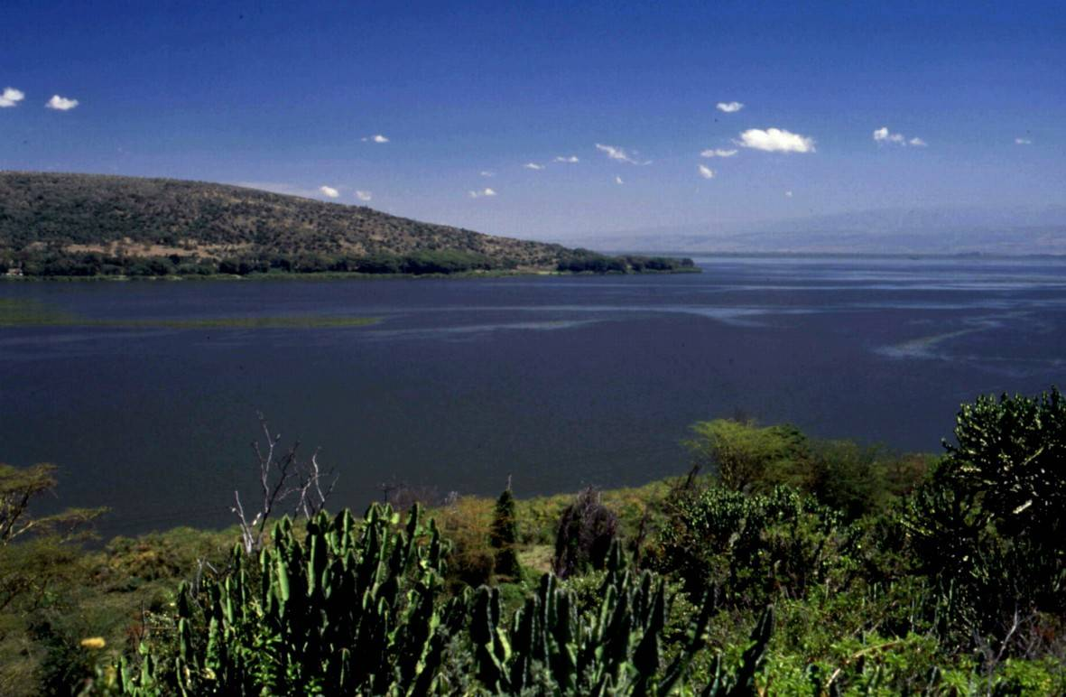
How would you describe this scene?
TARGET – Interesting adjectives!

Slide 2
What is the social cost of a valentines rose?
Aim
Understand the benefits and problems of the flower trade for people
(We will also be working hard on improving our extended writing)

Slide 3
Where is the flower industry in Kenya?
We will explore this using Google Earth.
As we do so think about the scale of the Lake and the flower farms that surround it

Slide 4
Why is the industry important to Kenya?
Read the information on ‘The growth of the Kenyan rose’ with a partner. We are going to start building up a bank of evidence to form our argument.
Answer the following question:
What statistics highlight the importance of the industry to Kenya? (Give examples)
Extension
What other information might be useful for us to research? Explain why you think this…

Slide 5
The cost to people…
Read through the information on ‘Working in the Kenyan flower industry’. This sheet contains a series of quotations from stakeholders in the industry. Quotations are excellent sources of evidence.
Analyse this evidence using these steps…
Put a plus or minus sign next to each comment depending on whether you think it is positive or negative.
Count up the total positive comments and negative comments, which are there more of?
Do the quotations give you an overall positive or negative impression of the effects on people?

Slide 6
Forming our argument…
Write a balanced argument based on the following statement.
“The flower industry is crucial to the people of Kenya”
Step 1 – Introduce the issue
Step 2 – Discuss the positives of the industry (using the evidence we gathered earlier)
Step 3 – Discuss the negatives of the industry (using the evidence we gathered earlier)
Step 4 – State and explain your overall opinion on the issue

